Slide 1
VPN Lab
VARSHA KOHIRKAR
PARVATHI CHANDRASEKHAR
SUDHA R V

Slide 2
Outline
What is VPN?
SeedUbuntu VMWare installation steps
Task 1: Host to Host Tunnel using Tun Interface
Task 2: Host to Gateway Tunnel
Task 3: Gateway to Gateway Tunnel
Task 4: Create a VPN
Task 5: Authentication and Key Exchange

Slide 3
VPN
Virtual Private Network
To create a private scope of computer communication
To provide a secure extension of a private network into an unsecure network like Internet
Can be built on IPSec or Secure Socket Layer (SSL)
In this lab, we have focus on SSL VPNs

Slide 4

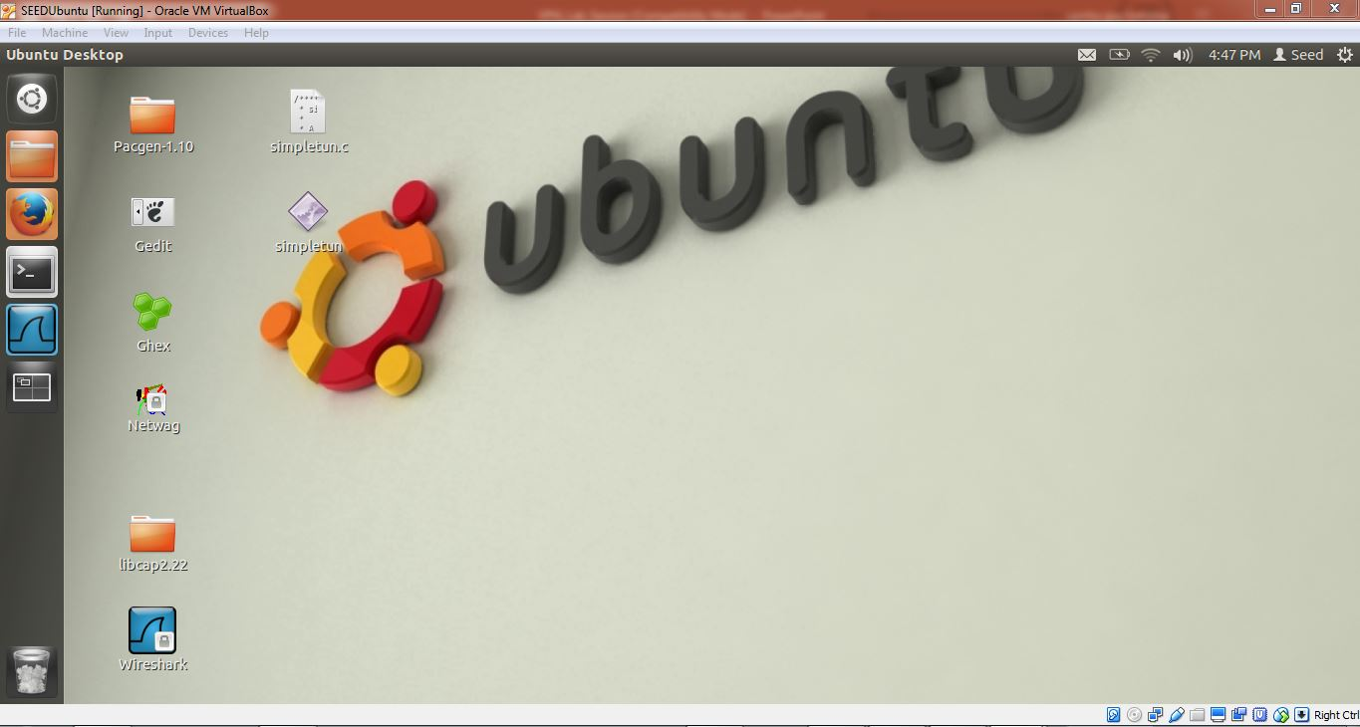




SeedUbuntu Installation with OpenSSL Library (to use to use OpenSSL package)

Slide 5
SeedUbuntu Installation (cont.)
OpenSSL package can be installed using the following command:
$ apt-get source openssl
After downloading the source package, .tar.gz file is unpacked and "./config", "make", "make install" is used to build and install the OpenSSL package.

Slide 6
Task 1
Host to Host Tunnel using Tun Interface
Tun interface is made active using command openvpn –mktun –dev tun2
UDP connection is established between two seed ubuntu

Slide 7
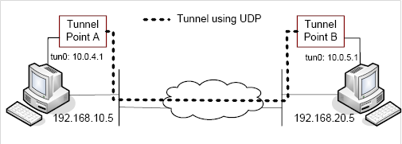
Host-to-Host Tunnel
Use UDP in the tunnel

Slide 8
Use of UDP in the tunnel
If the VPN uses TCP, then TCP connections will use IP packets sent through the VPN, so we end up paying the TCP overhead twice
However, an UDP-based VPN has the potential for slightly better performance because of lower overhead

Slide 9
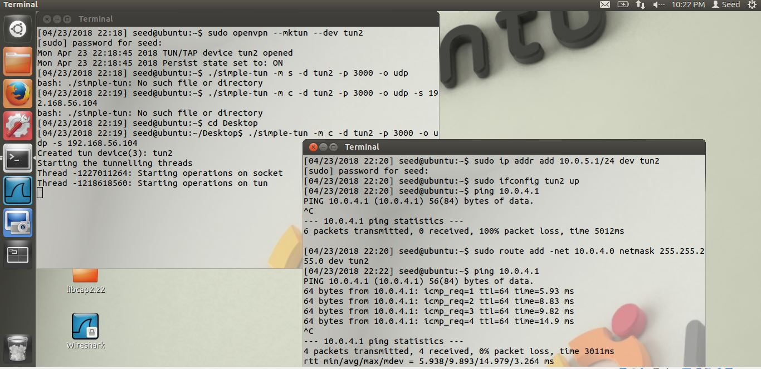
Screenshots: Client Contacting Server

Slide 10
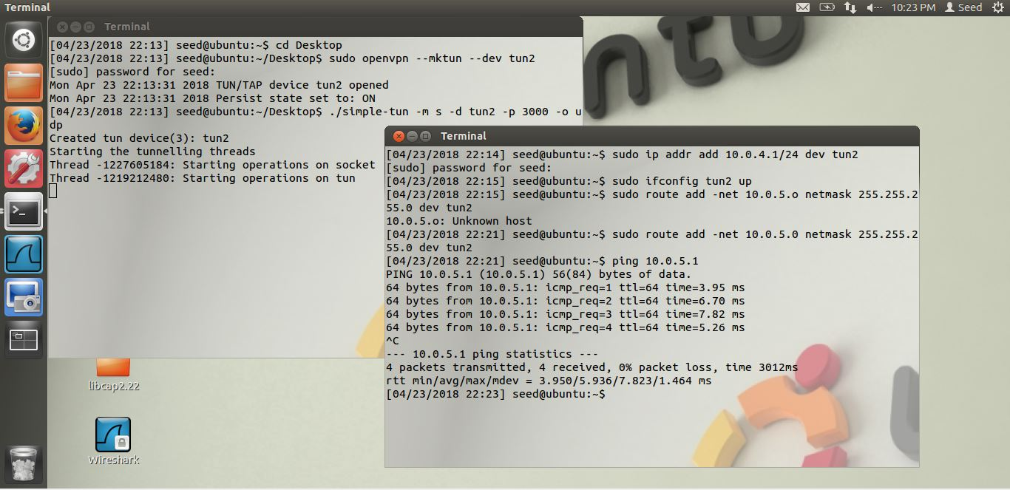
Screenshots: Server Contacting Client

Slide 11
Tun/tap Interface
virtual network kernel drivers
software-only interfaces, that is, they exist only in the kernel
No physical hardware component
Have a special file descriptors
A tap interface outputs (and must be given) full ethernet frames
A tun interface outputs (and must be given) "raw" IP packets

Slide 12
Tun/tap Interface (cont.)
When a program is attached to a TUN/TAP interface, the IP packets that the computer sends to this interface will be piped into the program;
the IP packets that the program sends to the interface will be piped into the computer, as if they came from the outside through this virtual network interface

Slide 13
Tun/tap Interface (cont.)
IP addresses can be assigned
traffic can be analyzed
routes pointing to it can be established

Slide 14
Host-to-Gateway Tunnel
Use two physical machines, one acting as a host, the other acting as the gateway, which has many other virtual machines
Use Port Forwarding to make certain port of the VM accessible to the outside
VMWare Setup
Gateway Setup
Host Setup

Slide 15
Host-to-Gateway Tunnel
Use two physical machines, one acting as a host, the other acting as the gateway, which has many other virtual machines
Use Port Forwarding to make certain port of the VM accessible to the outside
VMWare Setup
Gateway Setup
Host Setup

Slide 16
Gateway Setup
On one physical machine, we use one virtual machine as the gateway, the others as the internal hosts
Gateway Setup
Add another interface
Enable IP forwarding feature
Configure the routing table for gateway

Slide 17
IP forwarding
$ sudo sysctl net.ipv4.ip_forward=1

Slide 18
Add Routing Rules
man route – read the route manual page
Use route add, example
$ sudo route add -net 10.0.10.0 netmask 255.255.255.0 gw 10.0.20.1

Slide 19
Host Setup
Configure the routing table

Slide 20
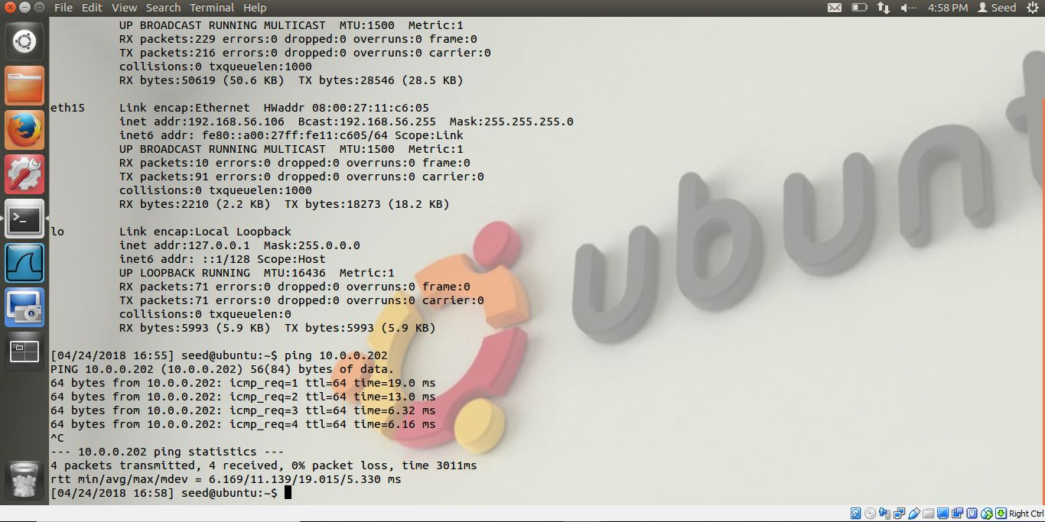
Task 2:Host To Gateway Tunnel

Slide 21
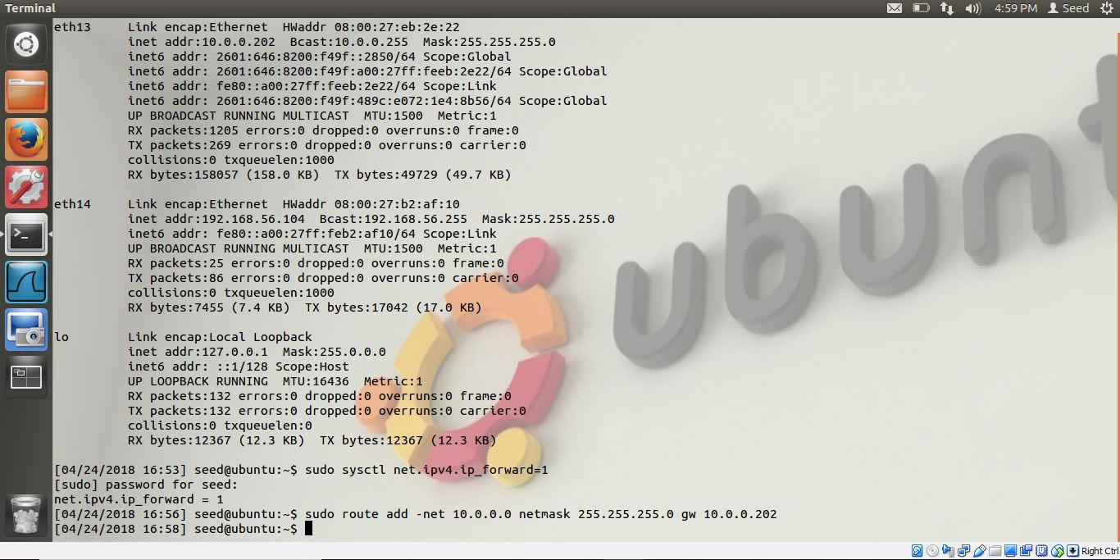
Screenshots:Gateway Ip Address

Slide 22
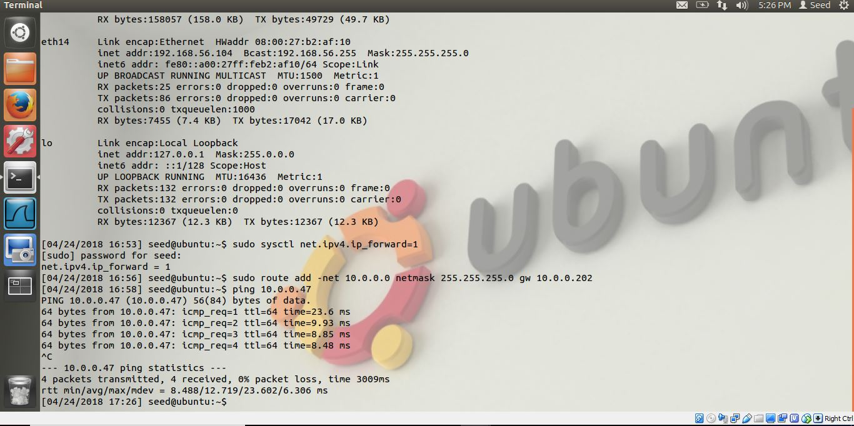
Task 3:Gateway To Gateway Tunnel

Slide 23
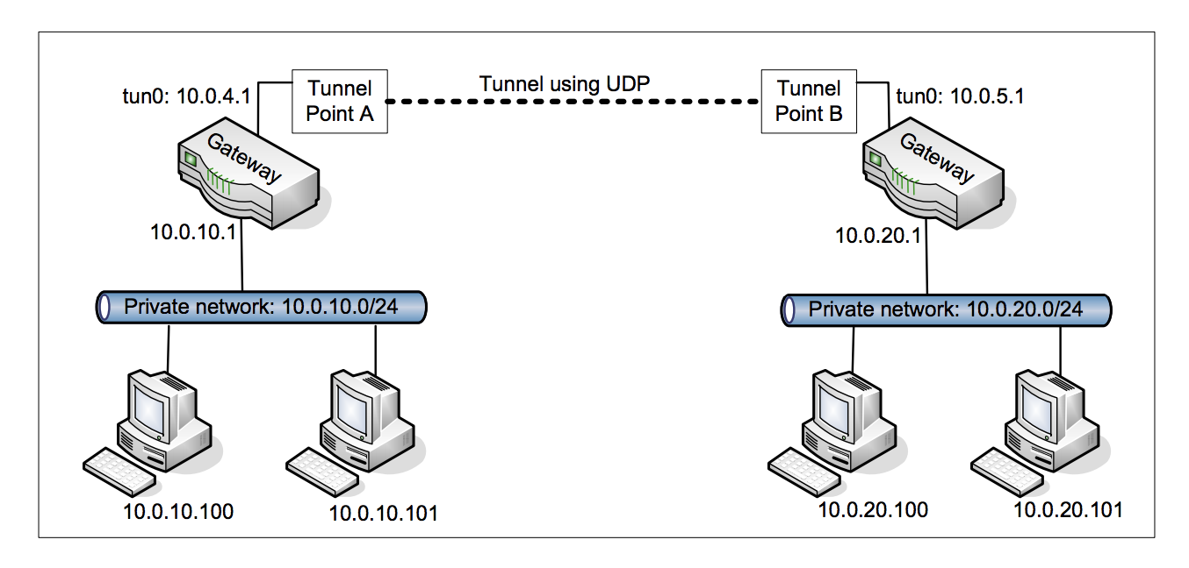
Gateway To Gateway Tunnel Setup

Slide 24
Task 4:Create a Virtual Private Network
To get a VPN, we need to secure the tunnel which we created between two machines.
For this,we need to achieve confidentiality and integrity.
We are using AES encryption to encrypt the tunnel between client and VPN server.
We will establish the TCP connection between client and server and encrypt the data passing through with AES encryption

Slide 25
OpenSSL
Prepare work
apt-get source openssl
./config
make
make install
Directory of headers and libraries
/usr/local/ssl/include
/usr/local/ssl/lib

Slide 26
What OpenSSL does?
Encrypt/decrypt
Hash
Create certificates
APIs

Slide 27
Certificate Generation
First of all, Self signed certificate is generated for Certificate Authority(CA) at both client and server
This command will generate CA private key and CA public key certificate.
At server side,private-public key pair is generated using RSA algorithm so that CA can issue server a trusted public-key certificate.
For this Certificate Signing Request is generated and sent to CA from server to issue the certificate.
Same steps are replicated at client side to generate a certificate

Slide 28
Setting up a secure connection
Secure connections require a handshake after the connection is established.
the server sends a certificate to the client
the client then verifies against a set of trust certificates
It also checks the certificate to make sure that it has not expired
a trust certificate store be loaded prior to establishing the connection
The client will send a certificate to the server only if the server requests one

Slide 29
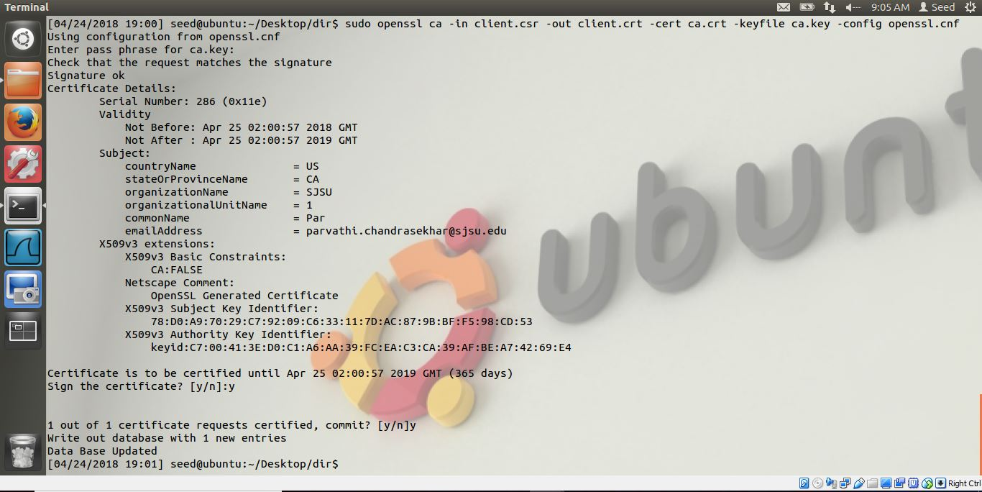
Screenshot For Certificate Generation

Slide 30
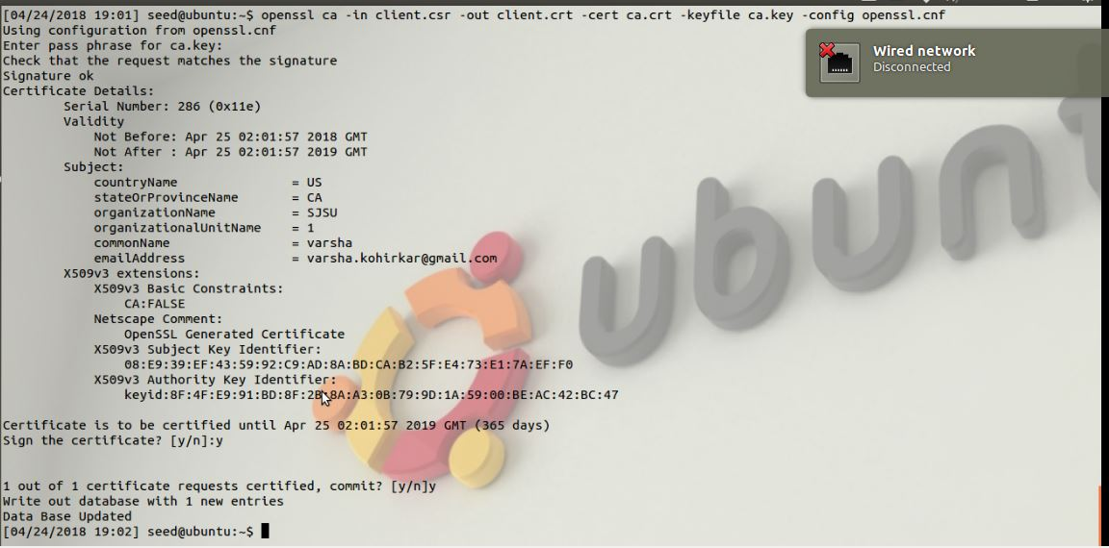
Client certificate generation

Slide 31
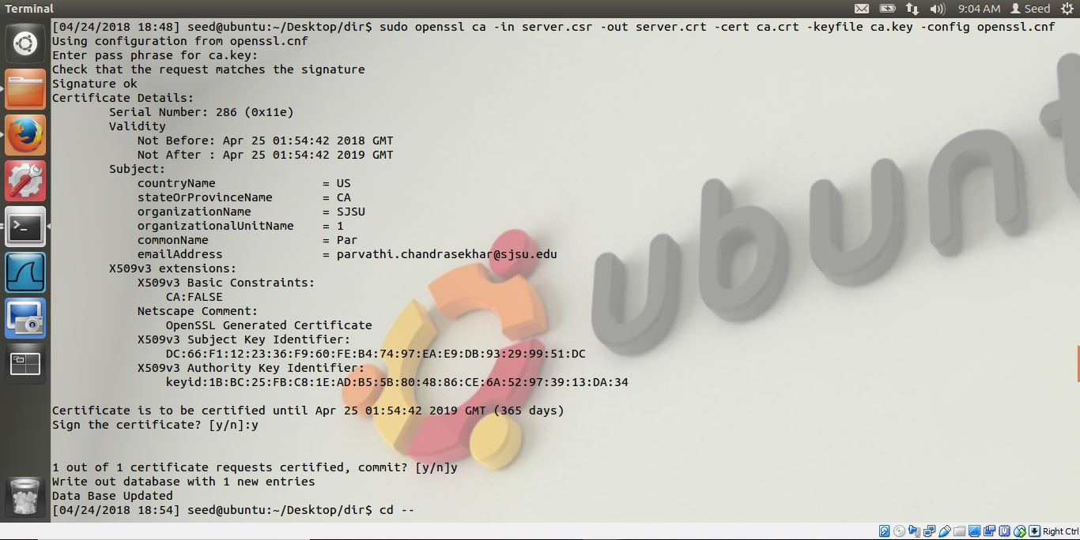
Server certificate generation

Slide 32
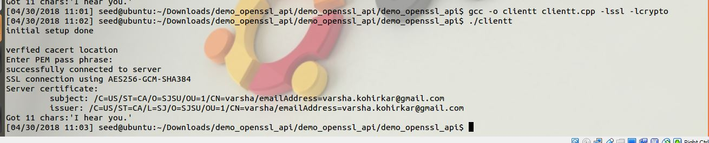
SSL connection using AES and SHA384,Server certificate verified

Slide 33
Supporting Multiple VPN Tunnels
VPN server allows more than one clients to connect to it simultaneously
Each client has its own VPN tunnel with the server, and the session keys used in different tunnels should be different
The server needs to figure out from which VPN tunnel the incoming packet comes from , to ensure proper decryption

Slide 34
References
http://waldner.netsons.org/d2-tuntap.php
http://www.mjmwired.net/kernel/Documentation/networking/tuntap.txt
http://waldner.netsons.org/d2-tuntap.php
http://sites.inka.de/~W1011/devel/tcp-tcp.html
http://waldner.netsons.org/d3-ssh-tuntap.php
http://www.madboa.com/geek/openssl/

Slide 35
Reference
http://www.securityfocus.com/infocus/1466
http://www.ibm.com/developerworks/linux/library/l-openssl.html
http://www.securityfocus.com/infocus/1388
http://www.securityfocus.com/infocus/1462

